Slide 1

Wild Animal Recognition
Professor: Ram Hariharan
Yanda, Yuan
Qifan,Wang
Xuejiao Dong
Wenwen,Ni
04/24/2020
Northeastern University
Boston, MA, USA

Slide 2
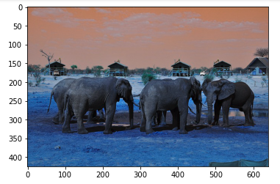
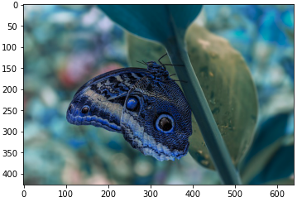
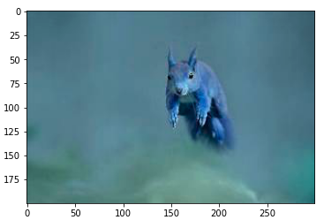
Background & Packages Used
1
1.1 Background
The Animal dataset contains around 8000 images of 5 classes of animals. We have five individual files that contains each species independently from one another.
Our project has two goals: （1）Wild Animal Recognition （2）Compare MLP & CNN
1.2 Packages Used
Packages：cv2 keras sklearn torch numpy seaborn os pandas tensorflow matplot talos

Slide 3

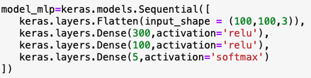
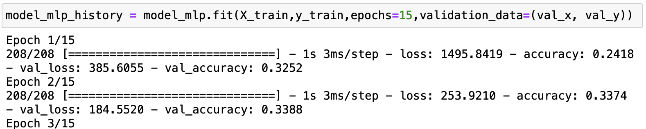
MLP-Model Implementation
2
2.1 Building MLP Model
Split data into test & train
Creating model_mlp
Compile the model_mlp
Training and evaluating the model_mlp

Slide 4
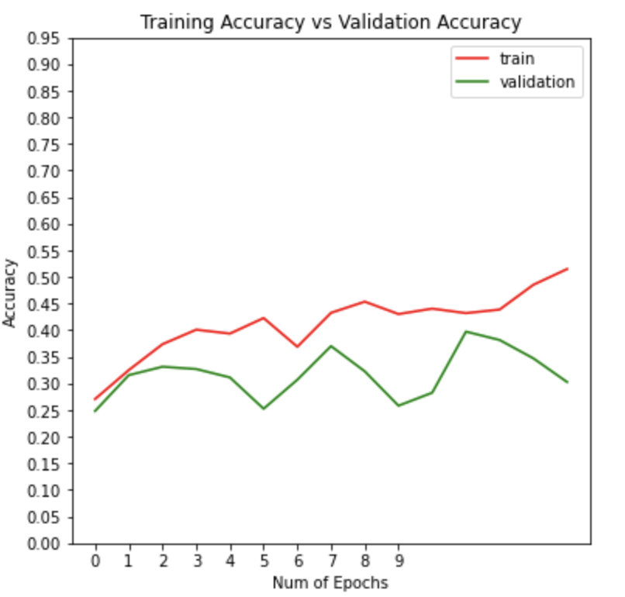
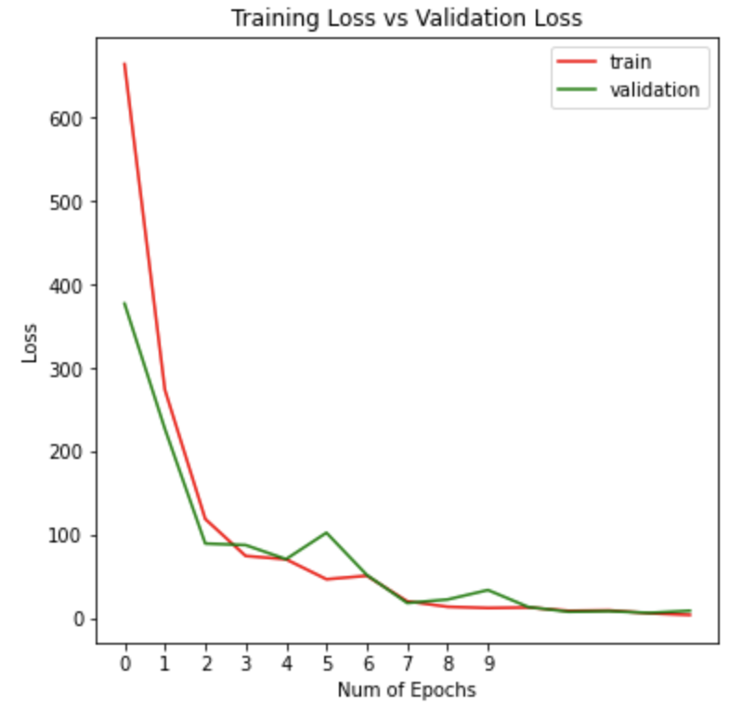
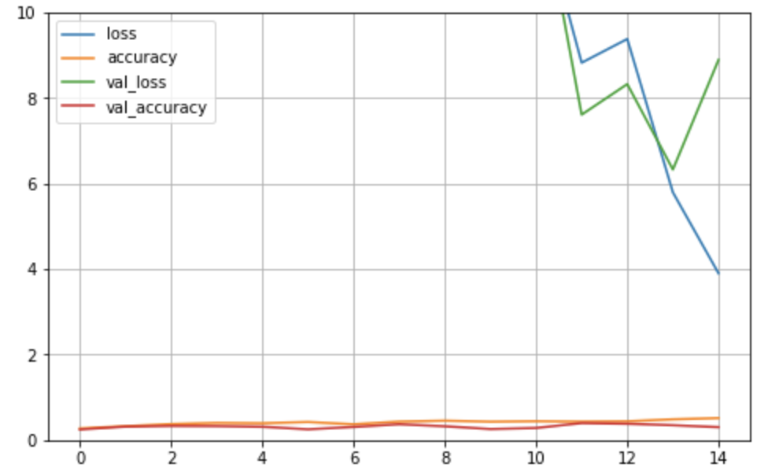
MLP-Model Implementation
2
2.2 MLP Model Visualization

Slide 5
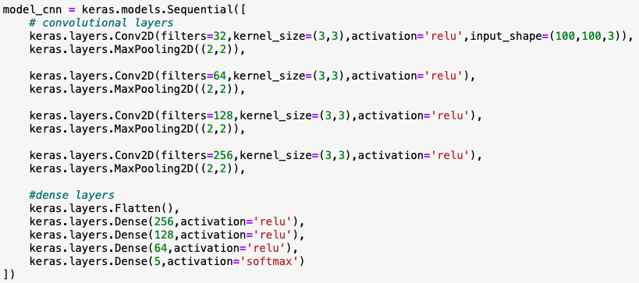
CNN-Model Implementation
3
3.1 Building CNN Model
Define convolution and pooling
Define dense layers
Compile model_cnn
Training and evaluation model_cnn

Slide 6
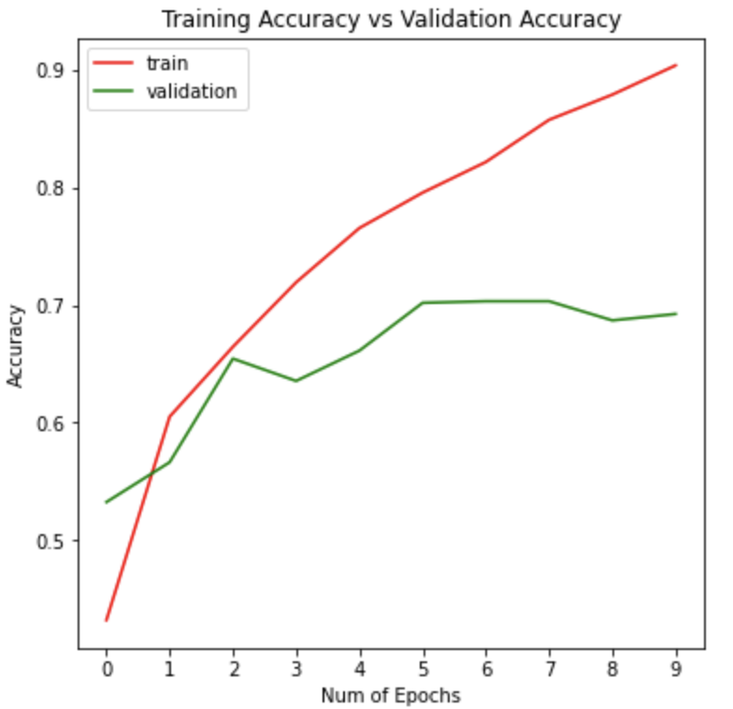
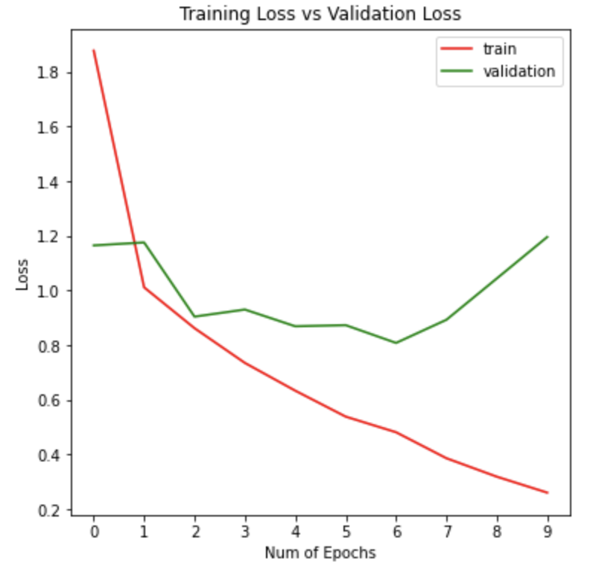
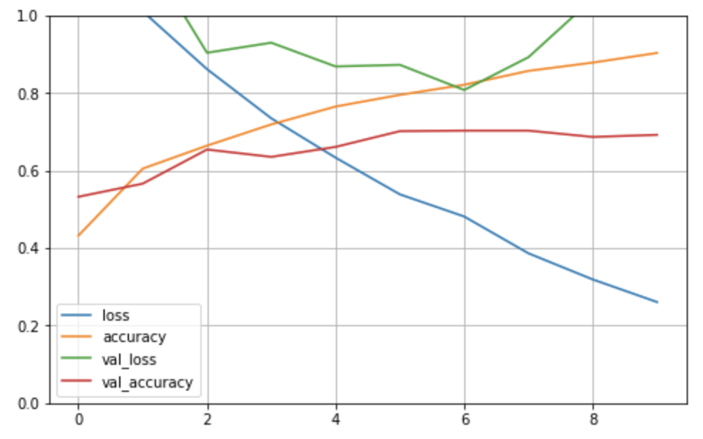
CNN-Model Implementation
3
3.2 CNN Model Visualization

Slide 7
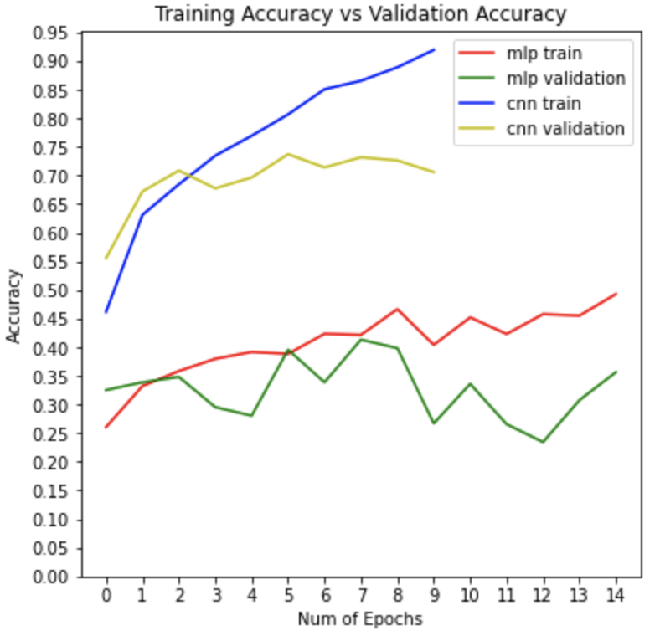
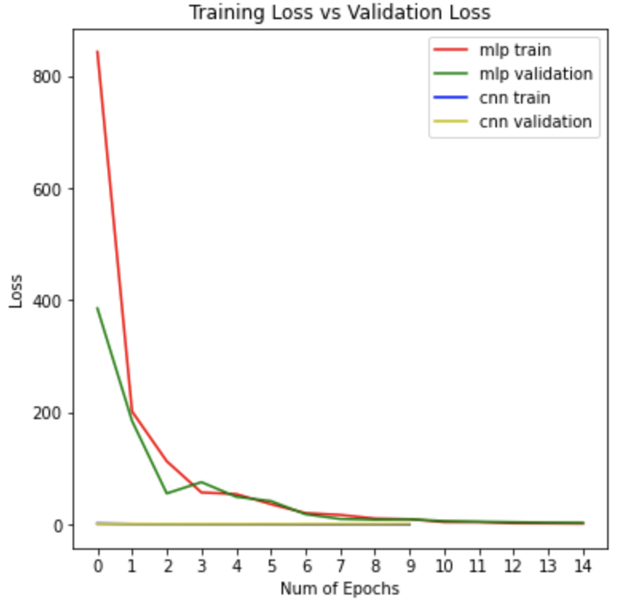
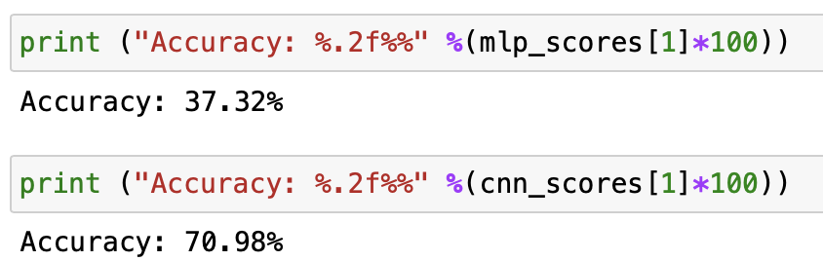
Conclusion
4
4.1:Accuracy：MLP vs. CNN
4.2:Comparision Conclusion
As we can see, CNN performs better than MLP, both in the accuracy of the results and in predicting the sample data. So, the CNN method is more applicable to the classification and prediction of images. Also, size of image when loading can influence the accuracy. For example, we are using 100x100 in this notebook however if we use 200x200 instead, the overall accuracy will increase 5-10%.

